Slide 1
Day 1: R for Open & Reproducible Science
David Souto
School of Psychology and Vision Sciences

Slide 2
Instructors team
David Souto, Lecturer, Open Science Team Lead
Samantha Tyler, Postdoctoral researcher, UoL & Bham
Anna Nowakowska, Early Career Fellow
Mahmoud Elsherif, Postdoctoral researcher

Slide 3
Why this workshop?
Provide researchers with basic tools to tackle challenges to reproducible science:
Knowledge
Statistical reasoning
Practical skill
Notes:
Four years of promoting OS within department in one intense workshop told us we need a focused workshop rather than repeating things across the year

Slide 4
Reproducible Science
Notes:
Very short intro – e.g paper

Slide 5
Open Science

Slide 6
Workshop program: Day 1
Session 1:
Session 2:
Session 3:

Slide 7
Workshop program: Day 2
Session 1:
Session 2:
Session 3:

Slide 8
Workshop program: Day 3
Session 1:
Session 2:
Session 3:

Slide 9
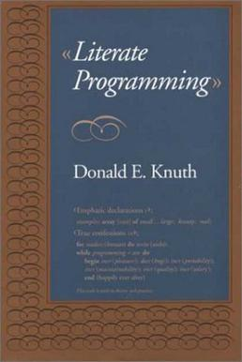
Literate programming
[Wikipedia example of lit prog]
Notes:
We are going to do this from the get go

Slide 10
How to interact with Worksheets
Live demo
Recorded here
Notes:
Source vs Visual ! Chunks … Execute code. Run exercises. Try things. Talk to your neighbours!

Slide 11
Levels
Level 1: What you need to know
Level 2: Desirable, not essential
Level 3: Maybe useful to some people

Slide 12
The R Studio interface
Live demo
Recorded here
[interface]

Slide 13
Session 1

Slide 14
Session 2

Slide 15
Session 3

